Slide 1

Angry Robot Studio
Team 6
Bryan, Kylie, Shanon, Adrian, Bobak, Jessica

Slide 2
Roles
Bryan Spahr: leading and coding
Adrian Campos: coding
Shanon Mathai: coding, rigging, (modeling)
Kylie Adkins: sketch artist
Jessica Candlebat: 2D to 3D conversion
Babak Shahian: level meshes

Slide 3
Game Name: Recovery
Setting
Metal sphere like planet floating in space(Deathstar)
Backstory
Protagonist crash lands on planet while repairing his ship.
Mission
To find his ship to return home, when found he needs parts to replace missing pieces of ship, that he will have to find on the planet, while avoiding enemies.
Game Design
3rd person shooter

Slide 4
Characters
Protagonist
Robot/human, (space suit)
Weapon
Gun (limited ammo, have to search for more)
Enemies
Other robots that live on the “planet”
Attack him because he is an intruder
When dead, stay laid on ground

Slide 5
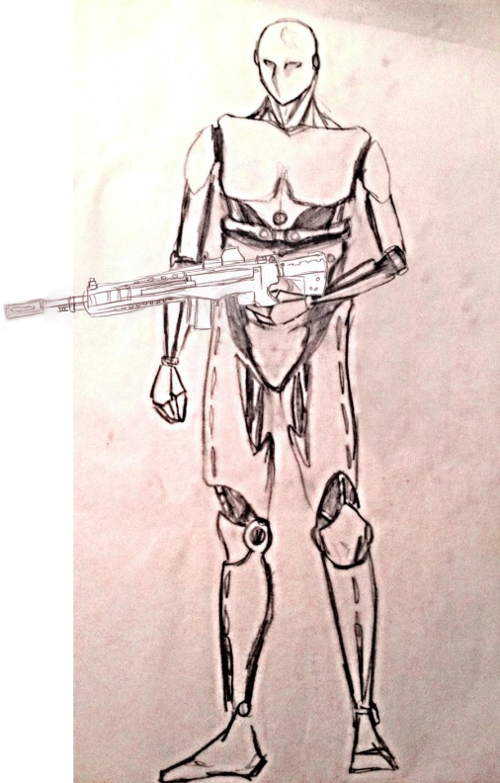
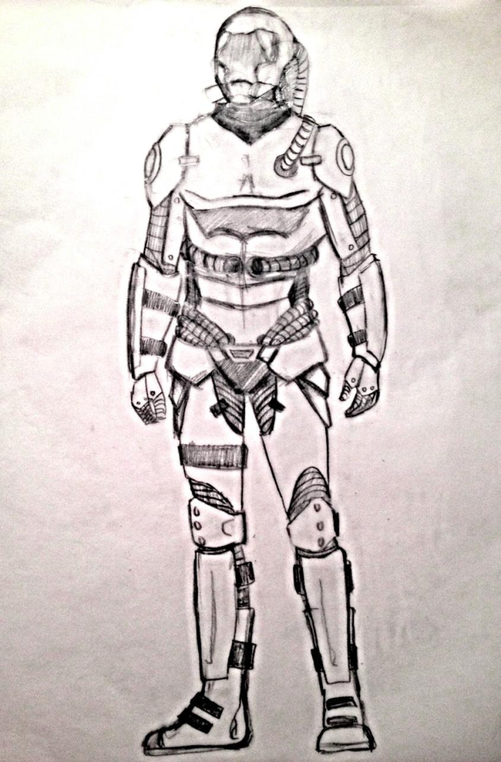
Sketches of enemy robot

Slide 6
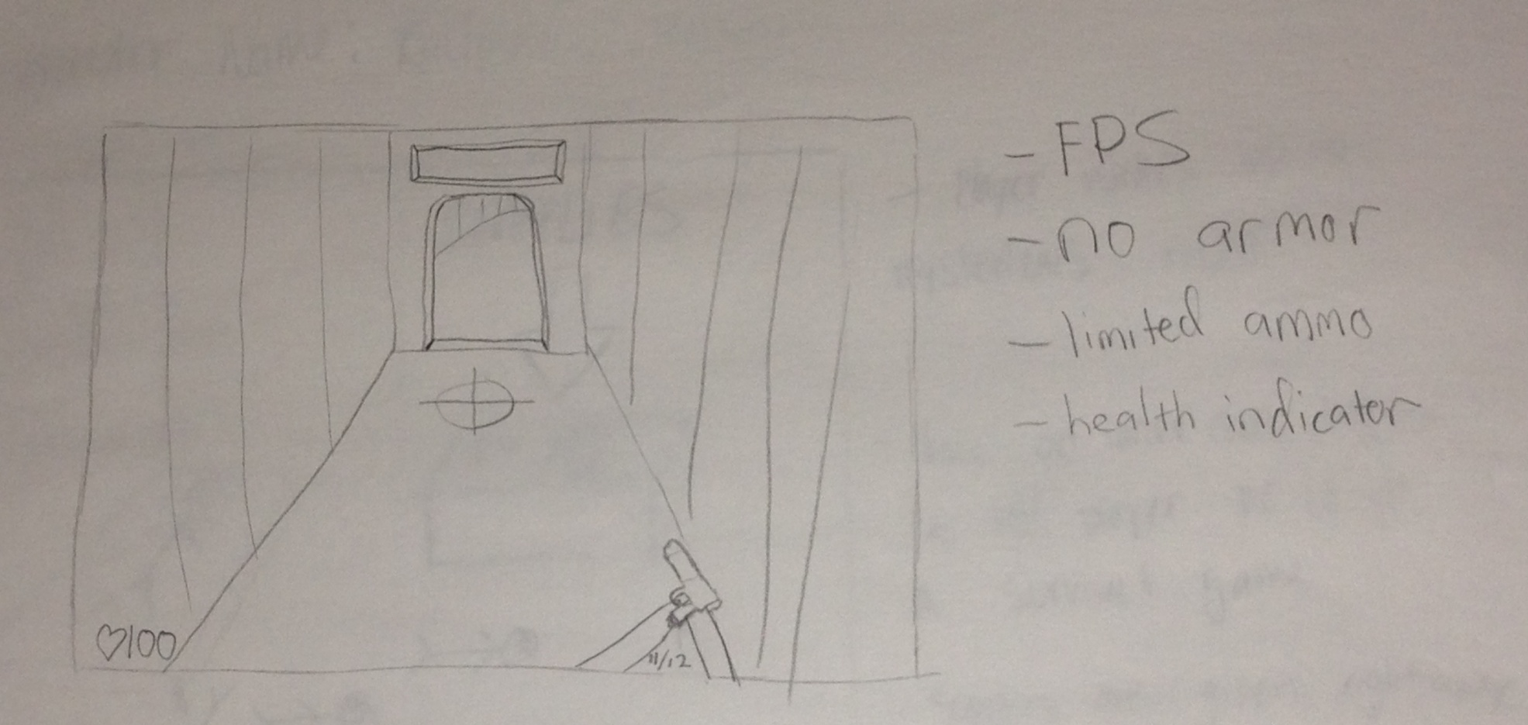

Slide 7
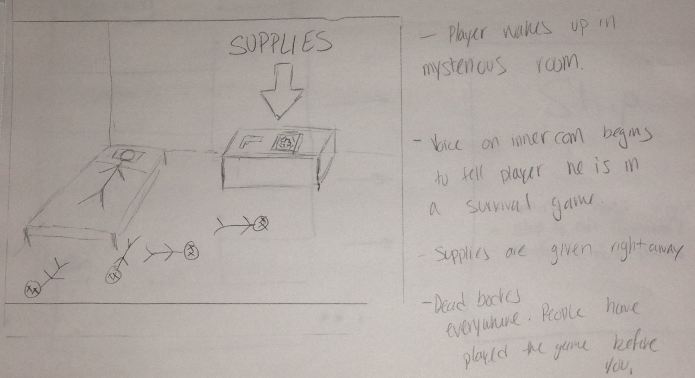

Slide 8
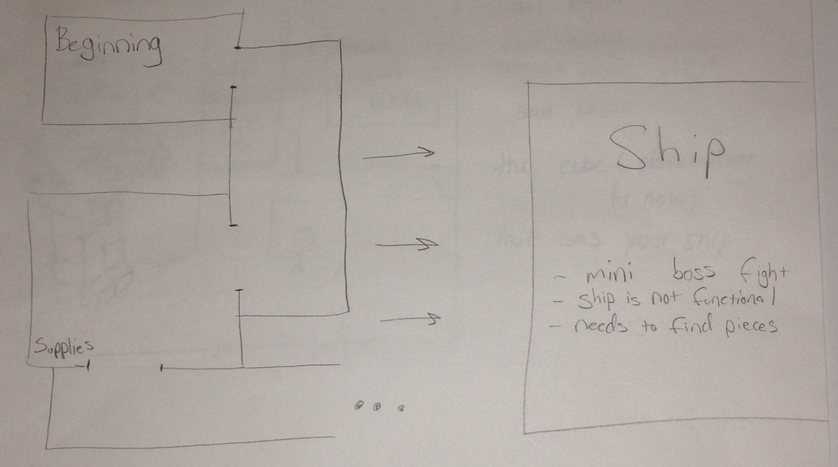

Slide 9
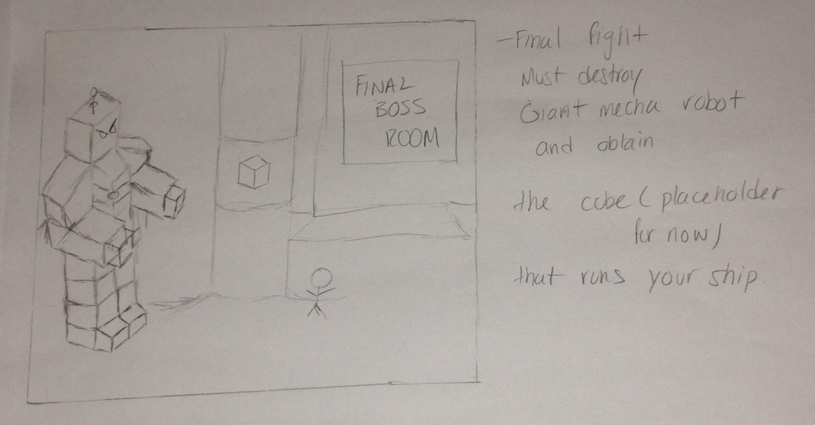

Slide 10
Website
http://sites.google.com/site/angryrobotstudio/

